Slide 1
Docker Security Overview (As of release 1.12)
Presenter Name: Sreenivas Makam
Presented at: Docker Meetup Bangalore
Presentation Date: July 9, 2016

Slide 2
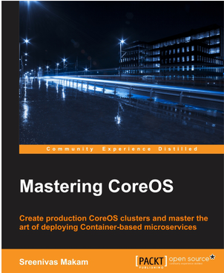
About me
Senior Engineering Manager at Cisco Systems Data Center group
Author of “Mastering CoreOS” https://www.packtpub.com/networking-and-servers/mastering-coreos/ )
Docker Captain(https://www.docker.com/community/docker-captains )
Blog: https://sreeninet.wordpress.com/
Code: https://github.com/smakam
Linkedin: https://in.linkedin.com/in/sreenivasmakam
Twitter: @srmakam

Slide 3
Docker Security modules
Docker Client
TLS
Docker
Engine
Container image
Capabilities
Seccomp
Registry
SELinux
AppArmor
TLS
Request/
Response
Security Scan
Image
Signing
Namespaces
Cgroups
Authorization
Multitenant
RBAC

Slide 4
Linux kernel - Container Security support
Namespaces – PID, Mount, Network, IPC, UTC, User.
Cgroups – Limit CPU, Memory, IO
Capabilities – Reduced root access. 36 capabilities to control as of kernel 3.19.0.21.
Seccomp profiles – Control kernel system calls. 300+ system calls available that can be controlled using these profiles.
Special kernel modules like AppArmor, SELinux – Provides granular control over Kernel resources.

Slide 5
Namespaces – PID, Mount
With PID namespace, each Container gets its own process ID namespace.
With Mount namespace, each Container gets its own copy of filesystem.
docker run -ti --name ubuntu1 -v /usr:/ubuntu1 ubuntu bash
docker run -ti --name ubuntu2 -v /usr:/ubuntu2 ubuntu bash
PID namespace:
Ubuntu1 Container:
root@3a1bf12161c9:/# ps
PID TTY TIME CMD
1 ? 00:00:00 bash
15 ? 00:00:00 ps
Ubuntu2 Container:
root@8beb85abe6a5:/# ps
PID TTY TIME CMD
1 ? 00:00:00 bash
14 ? 00:00:00 ps
Host:
$ ps -eaf|grep root | grep bash
root 5413 1697 0 05:54 pts/28 00:00:00 bash
root 5516 1697 0 05:54 pts/31 00:00:00 bash
Mount namespace:
Ubuntu1 Container:
root@3a1bf12161c9:/# ls /
bin dev home lib64 mnt proc run srv tmp usr boot etc lib media opt root sbin sys ubuntu1 var
Ubuntu2 Container:
root@8beb85abe6a5:/# ls /
bin dev home lib64 mnt proc run srv tmp usr boot etc lib media opt root sbin sys ubuntu2 var

Slide 6
Namespaces – Network, UTS
With Network namespace, each Container gets its own interfaces along with IP address.
Ubuntu1 Container:
root@3a1bf12161c9:/# ifconfig
eth0 Link encap:Ethernet HWaddr 02:42:ac:15:00:02 inet addr:172.21.0.2 Bcast:0.0.0.0 Mask:255.255.0.0 inet6 addr: fe80::42:acff:fe15:2/64
Ubuntu2 Container:
root@8beb85abe6a5:/# ifconfig
eth0 Link encap:Ethernet HWaddr 02:42:ac:15:00:03 inet addr:172.21.0.3 Bcast:0.0.0.0 Mask:255.255.0.0 inet6 addr: fe80::42:acff:fe15:3/64
With UTS namespace, each Container gets its own hostname and domainname.
Ubuntu1 Container:
root@3a1bf12161c9:/# hostname
3a1bf12161c9
Ubuntu2 Container:
root@8beb85abe6a5:/# hostname 8beb85abe6a5

Slide 7
Namespaces - IPC
IPC namespace isolates Message queues, Semaphores, Shared memory
Ubuntu 1 Container:
Create shared memory:
root@3a1bf12161c9:/# ipcmk -M 100 Shared memory id: 0
Display shared memory:
root@3a1bf12161c9:/# ipcs -m
------ Shared Memory Segments -------- key shmid owner perms bytes nattch status
0x2fba9021 0 root 644 100 0
Ubuntu 2 Container:
Create shared memory:
root@8beb85abe6a5:/# ipcmk -M 100 Shared memory id: 0
Display shared memory:
root@8beb85abe6a5:/# ipcs -m
------ Shared Memory Segments -------- key shmid owner perms bytes nattch status
0x1f91e62c 0 root 644 100 0

Slide 8
Namespaces - User
With User namespace, userid and groupid in a namespace is different from host machine’s userid and groupid for the same user and group.
User namespaces are available from Linux kernel versions > 3.8.
For example, root user inside Container is not root inside host machine. This provides greater security.
Docker introduced support for user namespace in version 1.10.
To use user namespace, Docker daemon needs to be started with “–userns-remap=username/uid:groupname/gid”. Using “default” for username will create “dockremap” user.
Host:
$ ps -eaf|grep bash
231072 4080 4040 0 22:45 pts/13 00:00:00 bash
$ cat /proc/4080/uid_map
0 231072 65536
(userid 0 in Container is mapped to 231072 in host)
Ubuntu1 Container:
root@3a1bf12161c9:/# id
uid=0(root) gid=0(root) groups=0(root)

Slide 9
cgroups
cgroups is a Linux kernel feature that provides capability to restrict resources like cpu, memory, io, network bandwidth among a set of processes.
Docker allows to create Containers using cgroup feature which allows for resource control for the specific Container.
Following is a Container created with user space memory limited to 500m, kernel memory limited to 50m, cpu share to 512, blkioweight to 400. (cpu share and blkioweight are ratios)
docker run -it -m 500M --kernel-memory 50M --cpu-shares 512 --blkio-weight 400 --name ubuntu1 ubuntu bash

Slide 10
Capabilities
In Linux, root user typically has all privileges enabled. Capabilities allow finer control for the capabilities that can be allowed for root user.
In Linux 3.19.0.21, there are 36 capabilities. All capabilities can be seen in “/usr/include/linux/capability.h”.
Examples of capabilities are setuid, setgid, socket access, set time.
Docker turns on only 14 capabilities by default for Containers started with default options.
Capabilities like insert/remove kernel modules, system clock manipulation are blocked.
Container with raw net capability turned off:
docker run -ti --name ubuntu1 --cap-drop=net_raw ubuntu bash
Network access blocked:
# ping google.com
ping: icmp open socket: Operation not permitted

Slide 11
Seccomp
Linux kernel feature that limits the system calls that a process can make based on the specified profile.
Docker uses Seccomp to control the system calls that Container can make.
Examples of system calls – bind, accept, fork.
Docker disables around 44 of 300+ system calls for Containers started with default options. Example of disabled system calls include mount, settimeofday.
Default Docker Seccomp profile is available here.
Profile disabling chmod system call:
{ "defaultAction": "SCMP_ACT_ALLOW",
"syscalls": [ { "name": "chmod", "action": "SCMP_ACT_ERRNO" } ] }
Seccomp illustration:
$ docker run --rm -it --security-opt seccomp:/home/smakam14/seccomp/profile.json busybox chmod 400 /etc/hosts chmod: /etc/hosts: Operation not permitted

Slide 12
Linux kernel Security modules – AppArmor, SELinux
Both AppArmor and SELinux are kernel modules that gives fine grained control to restrict access to system resources.
When AppArmor is active for an application, the operating system allows the application to access only those files and folders that are mentioned in its security profile.
SElinux is a labeling system. Every process, file, directory, network ports, devices has a label assigned to it. We write rules to control the access of a process label to an a object label like a file. The kernel enforces the rules specified in the policy.
In Redhat distributions, SELinux is supported. Ubuntu distributions supports AppArmor.
AppArmor profiles are easy to create, SELinux is difficult. SELinux profiles are more comprehensive compared to AppArmor.

Slide 13
Docker Engine Secure access
Docker engine runs as a daemon and by default listens on the Unix socket, “unix:///var/run/docker.sock”.
For accessing Docker engine remotely, “http” or “https” using TLS can be used.
“http” is not advised to be used for security reasons.
“https” with TLS provides confidentiality, authentication as well as integrity.
Certificates can be used to establish identity of client and server.
For testing purposes, Certificates can be generated using Openssl. For commercial purposes, certificates can be purchased from sources like CA.

Slide 14
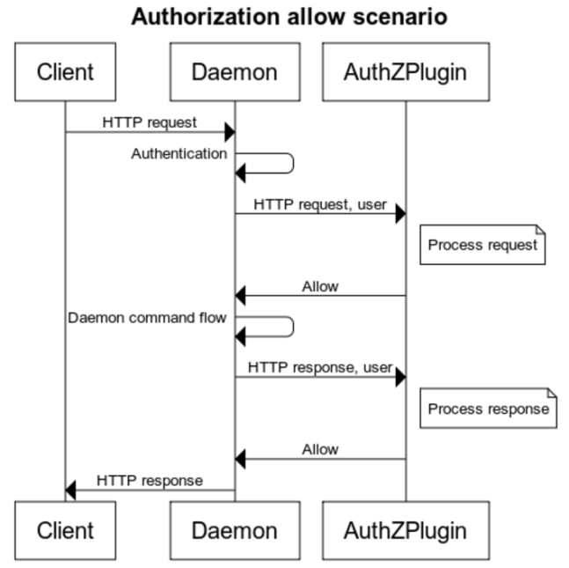
Authorization plugin
Authorization plugin can provide granular access to the Docker daemon based on userid, groupid, command executed, command arguments, time of day etc.
Authorization plugin informs Docker daemon if the specific command can be allowed or not based on the policy and the command executed.
Twistlock authz broker is one of the first plugins that is currently available.
In Twistlock case, policy is created as a JSON file and is given as argument to Docker daemon.
User identity support is not yet available in Docker engine.
Docker Data Center and Docker cloud provides RBAC and Multi-tenant support.
Policy.json:
{"name":"policy_1","users":[""],"actions":["container"] , "readonly":true} – Read-only Container policy
Starting Docker daemon with auth policy.json:
docker run -d --restart=always -v /var/lib/authz-broker/policy.json:/var/lib/authz-broker/policy.json -v /run/docker/plugins/:/run/docker/plugins twistlock/authz-broker

Slide 15
Container image signing
Container images needs to be signed so that the client knows that image is coming from a trusted source and that it is not tampered with.
Content publisher takes care of signing Container image and pushing it into the registry.
The Docker content trust is an implementation of the Notary open source project. The Notary open source project is based on The Update Framework (TUF) project.
When content trust is enabled, we can pull only signed images.
When content trust is not enabled, both signed and unsigned images can be pulled.
Docker content trust is enabled with “export DOCKER_CONTENT_TRUST=1”.
When the publisher pushes the image for the first time using docker push, there is a need to enter a passphrase for the root key .
When pushing new image or new image version, publisher needs to enter passphrase for repository key.
Docker has also added support for hardware keys using Yubikey
Keys should be saved safely and backups should be taken.

Slide 16
Container Image scanning
Docker Security Scan scans Container images and reports vulnerabilities.
Scanning is done by comparing each Container layer component with CVE databases.
Additional binary scan is done to make sure that the package is not tampered with.
Pro-active notification is given to both the publisher and user of Container images.
Available currently in Docker hub and Docker cloud. Will be added soon to Docker data center.

Slide 17
Docker Security - Best Practices
Docker enables Security by default and the default options suffice most of the needs. Following are few best practices:
Have separate containers for each micro-service keeping Container image size small.
Don’t put ssh inside container, “docker exec” can be used to ssh to Container.
Use only signed Container images.
Mount devices and volumes as read-only.
Run application as non-root. If root access is needed, run as root only for limited operations using features like Capabilities, Seccomp, SELinux/AppArmor.
Keep OS secure with regular updates. Using Container optimized OS is an option here since they provide automatic pushed update.
Store root keys, passphrase in a safe place and not expose in Dockerfile. Docker has plans to manage keys with Docker datacenter.
Use Docker official images. These images are curated by Docker so that the highest quality and security is maintained for the official images.
Use Container security scanning to check for vulnerabilities.
Use TLS for remote Docker daemon access.

Slide 18
References
Docker Security documentation(https://docs.docker.com/engine/security/security/)
Container namespaces (http://crosbymichael.com/creating-containers-part-1.html)
Docker Security article series (https://opensource.com/business/15/3/docker-security-tuning)
Docker Security blog series (https://sreeninet.wordpress.com/2016/03/06/docker-security-part-1overview/)
Docker Security scan(https://blog.docker.com/2016/05/docker-security-scanning/)
Authorization plugin (https://www.twistlock.com/2016/02/18/docker-authz-plugins-twistlocks-contribution-to-the-docker-community/)

